Slide 1
Policy, Systems, & environmental changes
Notes:
The Working on Wellness Environments Program is largely rooted in making PSE or policy, systems, and environmental changes in these communities in order to create an environment where the food system can be changed or adapted to make fresh foods accessible and to make physical activity a part of everyday life and make it more accessible. I will be defining what pse changes are.

Slide 2
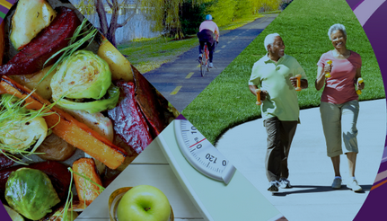
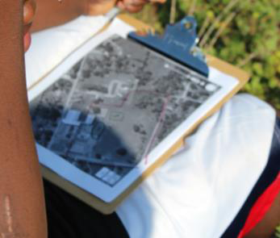
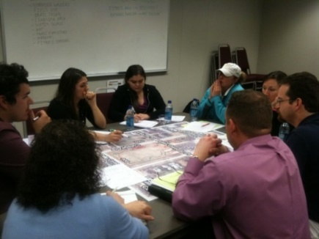
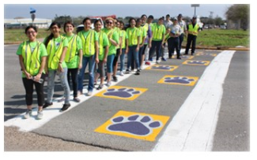
What is pse?
“Policy, Systems, and Environmental change is a way of modifying the environment to make healthy choices practical and available to all community members. Successful PSE strategies are evidence-based and multi-sector collaborations. By changing laws and shaping physical landscapes, a big impact can be made with little time and resources.
Source: http://plan4health.us/policy-systems-and-environmental-change-strategies/
https://smhs.gwu.edu/cancercontroltap/sites/cancercontroltap/files/PSE_Resource_Guide_FINAL_05.15.15.pdf
Notes:
It’s a different way to think about how to make healthy changes in a community. Many health programs focus on individual behavioral change. But making healthy changes isn’t always about individual choices but changing a community as a whole.

Slide 3
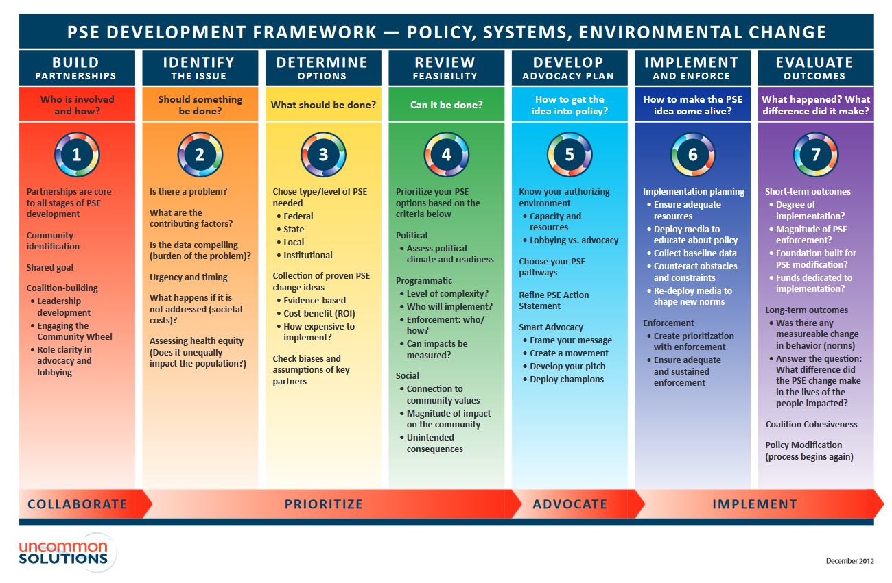
Source: https://www.nyspha.org/Resources/Documents/2013%20APHA%20Affiliate%20Mtg/Policy%20Framework%20and%20Tools/PSE_Framework_Dec12.pdf
Notes:
Here we have an example of the PSE Development Framework.

Slide 4
What are the advantages of using pse?
PSE approach has an impact on population health
Long-term approach that’s designed to make sustained improvement
Community engagement is essential to PSE success
Engagement empowers communities to take part and advocate for their own health
Systematic changes that occur at multiple levels in a community support more consistent long-term health improvements
Community Engagement also helps to identify community leaders who can offer a hand in overcoming cultural and social barriers to successful PSE Implementation
PSE is evidenced-based, decision making
Source: https://smhs.gwu.edu/cancercontroltap/sites/cancercontroltap/files/PSE_Resource_Guide_FINAL_05.15.15.pdf

Slide 5
Event/program vs. pse change
Event/Program
One time
Additive: often results in only short-term behavior change
Individual level
Not part of ongoing plan
Short term
Non-sustaining
Characteristics of PSE Change
Ongoing
Foundational: often produces behavior change over time
Community/Population level
Part of an ongoing plan
Long term
Sustaining
Source: http://healthtrust.org/wp-content/uploads/2013/11/2012-12-28-Policy_Systems_and_Environmental_Change.pdf

Slide 6
Examples of pse change in different settings
Setting | Policy Change | Systems Change | Environmental Change
Community | Safe Routes to School – City adopts policy reducing speed limit near school in order to encourage safe-routes to school and pedestrian safety | Local Food to Retail: City procurement systems change to source only healthy food for vending machines. | Farmer’s Markets: Small- farmers markets are opened at community-based organizations and clinics in underserved areas
Worksite | Santa Clara Healthy Food Policy requires 50% of food and beverages sold in county vending machines meet specific nutrition guidelines and sets nutrition standards for county sponsored meetings and events | Reimburse Prevention: Reimburse employees for preventive health and wellness activities | Healthy Options: Healthy food options are available for employees during the workday and at all meetings
Hospital | Hospital adopts a policy and process for operation of Farmer’s Markets onsite at the County Hospital, and Other County properties | Referral Systems: Develop a referral system to help patients access further nutrition and physical activity resources | Famer’s Markets: Onsite Farmer’s Market enhances staff and community access to fresh produce.
School | School District passes a Shared Use Policy for all campuses with PA infrastructure. | Farm to ECE: ECE providers partner to procure providers and cooking systems to incorporate fresh, local produce and other foods into meals and integrates it with classroom-based education about healthy eating | Walking routes between schools and other everyday destinations are improved for all users (not just students).
Source: http://eatbettermovemore.org/sa/policies/search_results.php?s_Search=nutrition

Slide 7
At the end of the day, an effective PSE approach should seek to reach populations and uncover strategies for impact that are sustainable.

